Slide 1
Snake in Neural Nets
Pearson Mewbourne

Slide 2
https://www.youtube.com/watch?v=q6s99eH9EC8&list=FLJsOcGrlnD2Uv4PlFTV4dlA

Slide 3
Where it all began
I was inspired by hw3
Inside, there’s the file pokemon.csv
It really got me thinking
Data driven?
Creates new pokemon?
But then I was inspired
NEURAL NETS!

Slide 4
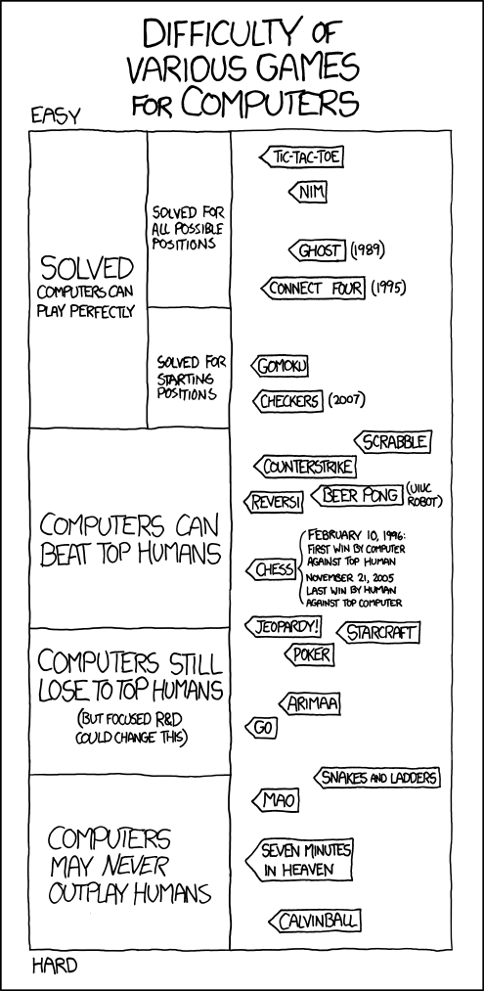
It was this image that changed my mind

Slide 5
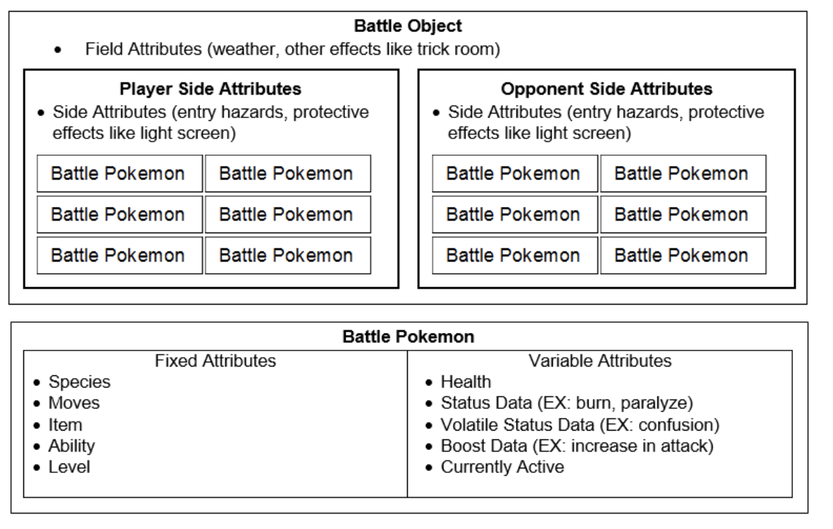
And this paper
https://varunramesh.net/content/documents/cs221-final-report.pdf
Too much data!

Slide 6
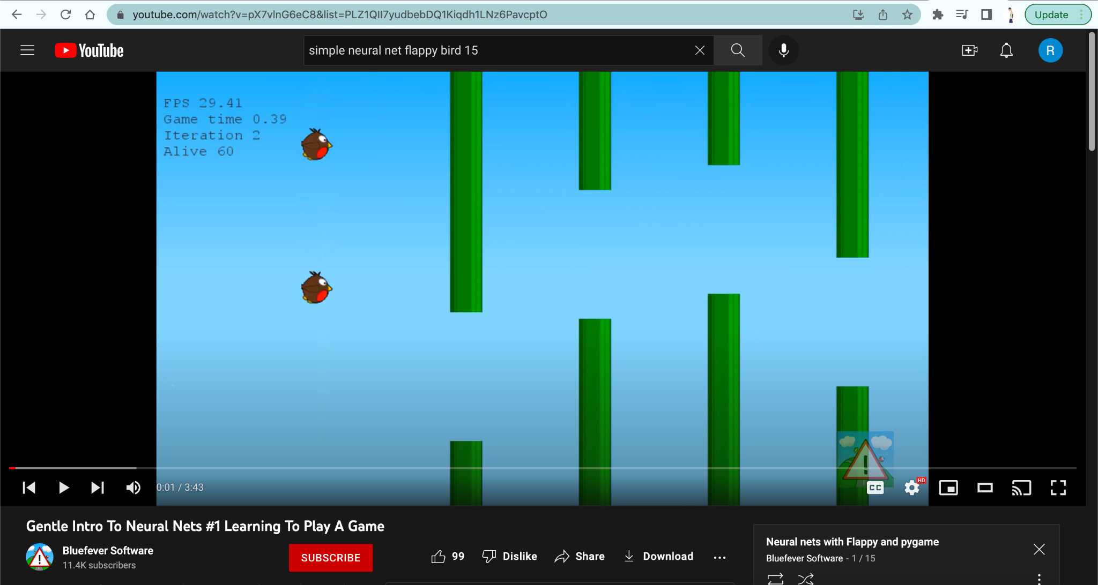
So… let’s scale it back
I wanted to learn how to make a neural net play a video game… so google lead me to this simple series

Slide 7



Libraries
Pygame - making the games
NumPy
SciPy

Slide 8
So I read through his code, commenting for my understanding, and I was able to make this!

Slide 9


Slide 10
But that’s not good enough!
I want it to learn another game
And I thought snake would work
Simple data
Simple actions
Simple goals
So I found a version of snake made in pygame and tried to jam the two codes together
Which lead to this…

Slide 12
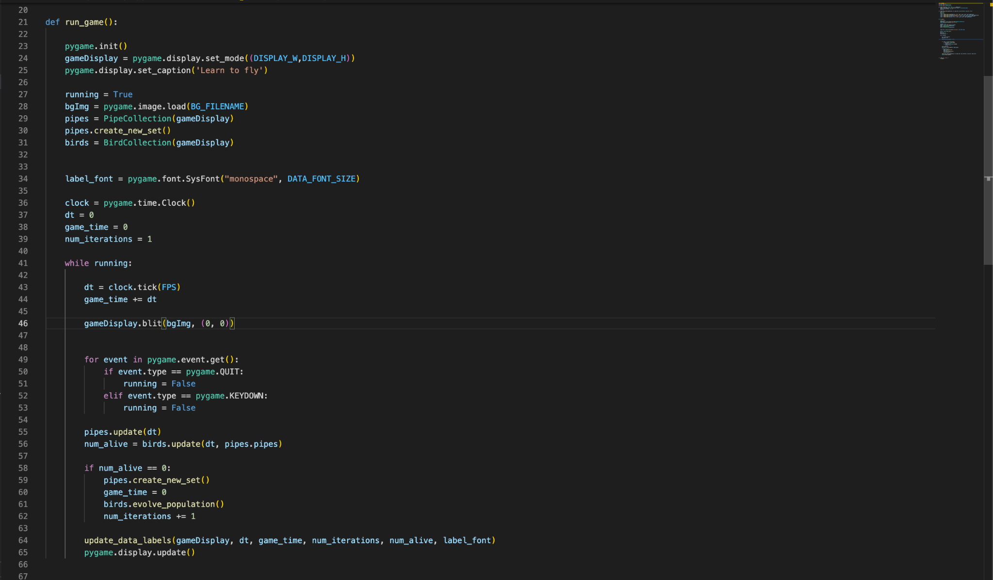
Stylistic differences

Slide 13
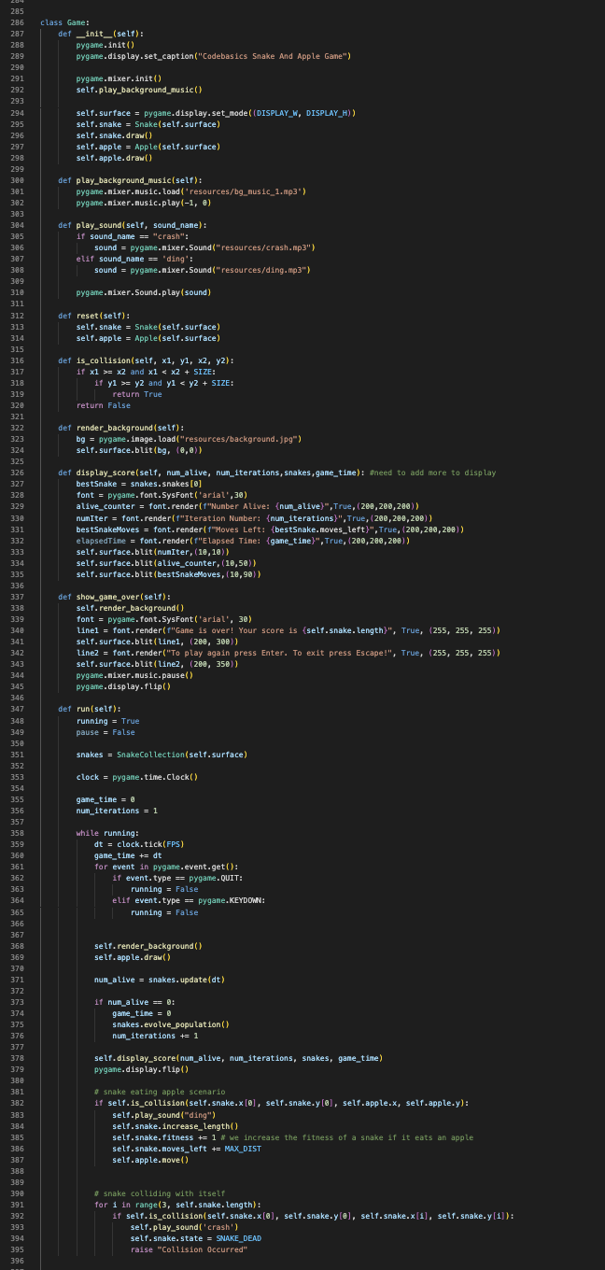

Not very succinct

Slide 14
What next?
Well obviously, I need to fix the snake code itself.
But I also want to return to my original idea!
I’ve already found APIs:
The API to scrape Pokemon Showdown
The API to scrape Smogon, a website with Pokemon stats and data

Slide 15
More things I need for that
A better understanding of PyGame or another way to represent the Game
Knowledge of how to make a neural net that can interact with websites
A neural net that can play against itself to improve
Dedication- this will take time

Slide 16
Thank You!

Slide 17
Sources
Percymon: A Pokemon Showdown Artifical Intelligence
Neural Nets with Flappy and PyGame
Snake in PyGame

